Slide 1


GO! with Microsoft 365®
Access 2025 Edition
Chapter 1
Getting Started with Microsoft Access
Copyright © 2026, 2023, 2020 Pearson Education, Inc. All Rights Reserved
Notes:
If this PowerPoint presentation contains mathematical equations, you may need to check that your computer has the following installed:
1) Math Type Plugin
2) Math Player (free versions available)
3) NVDA Reader (free versions available)
GO! With Microsoft 365
Access 2025 Edition
Chapter 1: Getting Started with Microsoft Access

Slide 2
Learning Objectives (1 of 2)
1.1 Identify Good Database Design
1.2 Create a Table and Define Fields in a Blank Desktop Database
1.3 Change the Structure of Tables and Add a Second Table
1.4 Create a Query, Form, and Report
1.5 Close a Database and Close Access
Notes:
The objectives of this chapter are:
1.1 Identify Good Database Design
1.2 Create a Table and Define Fields in a Blank Desktop Database
1.3 Change the Structure of Tables and Add a Second Table
1.4 Create a Query, Form, and Report
1.5 Close a Database and Close Access

Slide 3
Learning Objectives (2 of 2)
1.6 Open an Existing Database
1.7 Organize Objects in the Navigation Pane
1.8 Create Table Relationships
1.9 Sort Records in a Table
1.10 Filter Records
Notes:
Additional objectives of this chapter are:
1.6. Open an Existing Database
1.7. Organize Objects in the Navigation Pane
1.8. Create Table Relationships
1.9. Sort Records in a Table
1.10. Filter Records

Slide 4
Identify Good Database Design (1 of 4)
Access 2025 is a relational database management system
Database—organized collection of data
Information—data organized in a useful manner
Flat database—simple database, not related to other data
Relational database—database, multiple collections are related
Notes:
Access is a relational database management system, referred to as a D B M S which is software that controls how related pieces of data are stored, organized, retrieved, and secured. There are two basic types of database systems, a flat or simple database and a relational database. In a flat database, there are no related pieces of data. In a relational database, there are multiple pieces of data that are related in some way to each other.
An example of a flat database would be your address book. You would not need to duplicate any addresses.
An example of a relational database could be a store’s inventory because there should also be a list of suppliers. There should be separate tables for the inventory and the suppliers, with a field that would relate them in some way, like a supplier identification field.

Slide 5
Identify Good Database Design (2 of 4)
Tables—foundation of an Access database
Record—all the data relating to one person, place, event, thing, or idea
Field—single piece of information for every record
Notes:
When creating a database, the first step is to decide what information you want to be included, what questions should the database answer. The purpose of the database is to have the information in the database so the answers to any questions would be easy to find.
Tables are the foundation of an Access database. All information is stored in tables. Tables are similar to an Excel spreadsheet because they are created in columns and rows.
A table row is a record with the categories of information about a single person, place, event, thing, or idea.
A table column is a single piece of information in a record. For example, a name could be stored as three fields - last name, first name, and middle initial.

Slide 6
Identify Good Database Design (3 of 4)
First principle of good database design
Organize data so there is no duplication of information
Second principle of good database design
Use techniques to ensure that data is consistent
Notes:
The first principle of good database design is to organize the data in such a way that there is no duplication of information. For instance, a supplier changed its location. Instead of creating a new record for that supplier, modify the existing record with the change.
The second principle of good database design is to use techniques to ensure that the data is entered in such a way that it is consistent. A good example would be with the way the state is referred to. Some people abbreviate the state when they refer to it, others do not, so to be consistent, you would decide which way you would enter the state.

Slide 7
Identify Good Database Design (4 of 4)
Normalization is important because your goal in creating a database is to have it perform as expected.
Tables in a relational database are joined to one another on a common field.
Notes:
Normalization is important because your goal in creating a database is to have it perform as expected.
Tables in a relational database are joined to one another on a common field—a field that is in both tables.

Slide 8
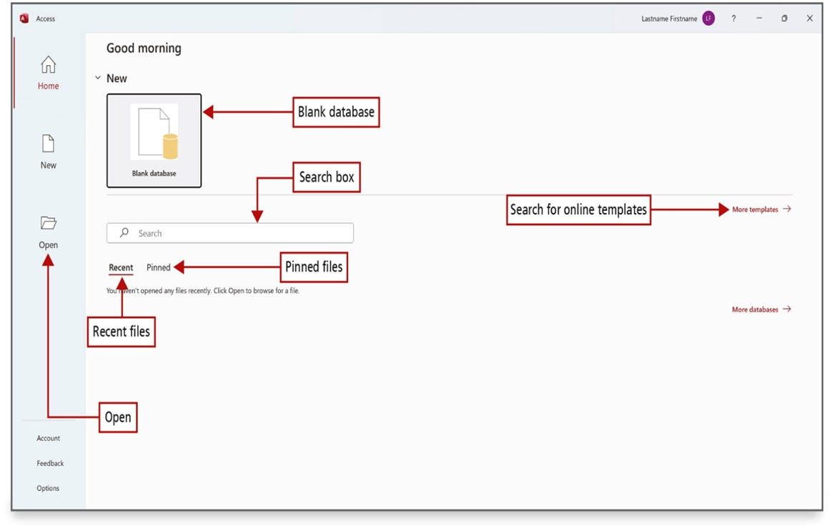
Create a Table and Define Fields in a Blank Desktop Database (1 of 9)
Notes:
A database template is a preformatted database designed for a specific purpose.
From this screen, you can open an existing database, create a new custom web app database, create a blank database, or create a new database based on a template.
A blank desktop database is stored on your computer or other storage device. It is a shell with no data. You create the data and tools as they are needed.
Long Description:
An opened folder icon with the text open is labeled open other files. An icon with a stack of cylindrical structures and a page with a fold on the right corner with text reads blank database is labeled blank database. A textbox with a magnifying icon and a label “search” is labeled search box. An option reads Recent (selected) is labeled recent files. An option reads Pinned is labeled Pinned files. A button reads More templates rightward arrow is labeled search for online templates.

Slide 9
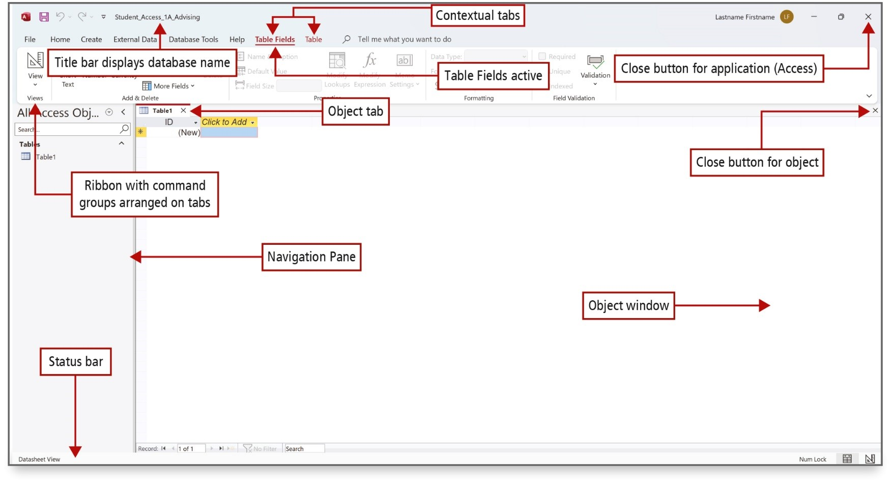
Create a Table and Define Fields in a Blank Desktop Database (2 of 9)
Notes:
When you create a blank database, it opens in Datasheet view. The new table - Table 1 – displays on an object tab in the object window, Table 1 is the default name for a new, unnamed table. Datasheet view looks like an Excel spreadsheet because it is set up in columns and rows.
Long Description:
The screenshot shows the title bar reading Student underscore Access underscore 1 A underscore Advising labeled title bar displays database name. Table fields and Table menus in the ribbon are labeled contextual tabs. Table fields is highlighted and underlined, and is labeled Table Fields active. Ribbon with commands is labeled ribbon with command groups arranged on tabs. A cross icon on the top right corner is labeled close button for application (Access). A pane with items on the left is labeled Navigation pane. A horizontal bar at the left bottom is labeled Status bar. A page titled Table 1 with close button below the ribbon is labeled object tab. The space in the object tab is labeled object window. The cross button on the top right corner of the object tab is labeled the close button for the object.

Slide 10
Create a Table and Define Fields in a Blank Desktop Database (3 of 9)
Access Window Element | Description
Navigation Pane | Displays the database objects that can be opened in the object window.
Object tab | Identifies the open object.
Object window | Displays the active or open object(s), including tables, queries, or other objects.
Close button for object | Closes the active object.
Ribbon | Displays commands grouped by related tasks and stored on different tabs.
Status bar | Indicates the active view and the status of action occurring within the database on the left; provides buttons on the right to switch between Datasheet view and Design view.
Table Tools | Provides tools on two tabs for working with the active table object, these are contextual tabs—only available when a table object is active.
Close button for application | Closes the active database and Access.
Notes:
The table describes the Access window elements shown in the previous slide.

Slide 11
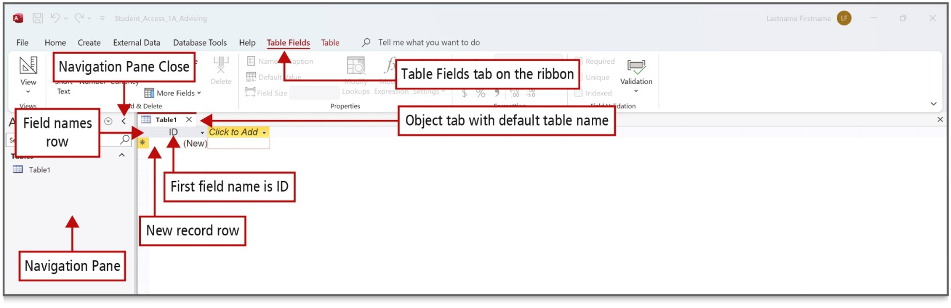
Create a Table and Define Fields in a Blank Desktop Database (4 of 9)
Notes:
The Navigation Pane displays and organizes the objects in a database. In Table 1, Access created the first field named I D. The data type classifies the type of data that can be stored in a field. The I D field stores a unique sequential number for each record.
Long Description:
Table Fields selected, and underlined in the ribbon and is labeled Table Field is tab on the ribbon. A pane on the left with item lists is labeled navigation pane. A shutter bar close button, a leftward arrow head labeled Navigation Pane Close is on the top right of the navigation pane. The tab titled Table 1 labeled object tab with default table name is in the object window. The top row is labeled field names row. The first row first column is labeled first field name is I D. The second row with text reads (New) is labeled new record row.

Slide 12
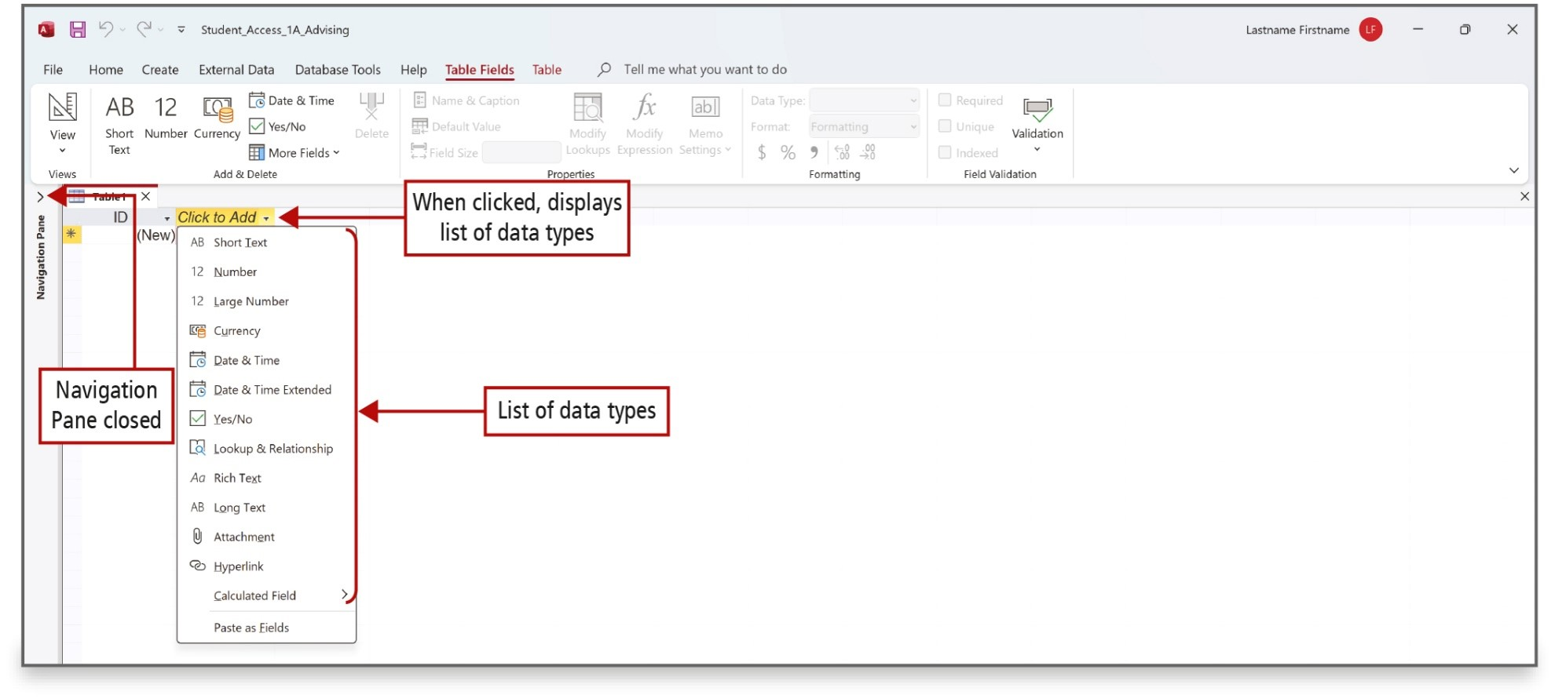
Create a Table and Define Fields in a Blank Desktop Database (5 of 9)
Notes:
A data type classifies the kind of data that you can store in a field, such as numbers, text, or dates. A field in a table can have only one data type.
Field names should be specifically related to the data included in the table. Examples of field names are Last Name, First Name, and Middle Initial. Many designers do not use spaces in field names, so Last Name would become LName.
Long Description:
The screenshot of an Access file window shows the shutter bar of navigation pane closed with expand button labeled navigation pane closed. Click to Add drop down menu on row 1 is labeled When clicked, displays list of data. A drop-down menu with fourteen items labeled list of data types below the click to add drop down menu.

Slide 13
Create a Table and Define Fields in a Blank Desktop Database (6 of 9)
Examples of data types
Short Text—up to 255 characters
Date & Time—date or time
Auto Number—unique sequential numbers
Currency—amounts
Notes:
Examples of commonly used data types are Short Text, Date & Time, Auto Number, and Currency.
Fields such as Postal Code should be assigned Short Text because the field will never be used in a calculation.
Fields that involve numbers should be assigned an appropriate number type so that calculations can be performed.

Slide 14
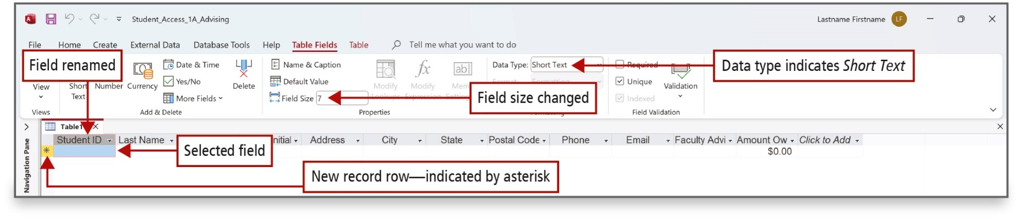
Create a Table and Define Fields in a Blank Desktop Database (7 of 9)
Notes:
Once the fields have been created, click in the New record row and begin to enter the first field for the first record. Pressing Tab or Enter at the end of each field automatically moves the insertion point to the next field. Pressing Tab or Enter at the end of the last field automatically moves the insertion point to the first field of the next record.
Fields can be renamed to better describe the LName, or you can add a Caption that will display differently. For example, a field might be named LName, but the caption might display Last Name. You can also change the field size of a field.
Long Description:
A screenshot of an access file shows Data type with short text on the ribbon is labeled Data type indicates Short Text. Field size 7 on the ribbon is labeled Field size changed. Student I D labeled field renamed is on first row first column. Asterisk on the second row is labeled New record row-indicated by asterisk. The second row first column is highlighted and labeled Selected field.

Slide 15
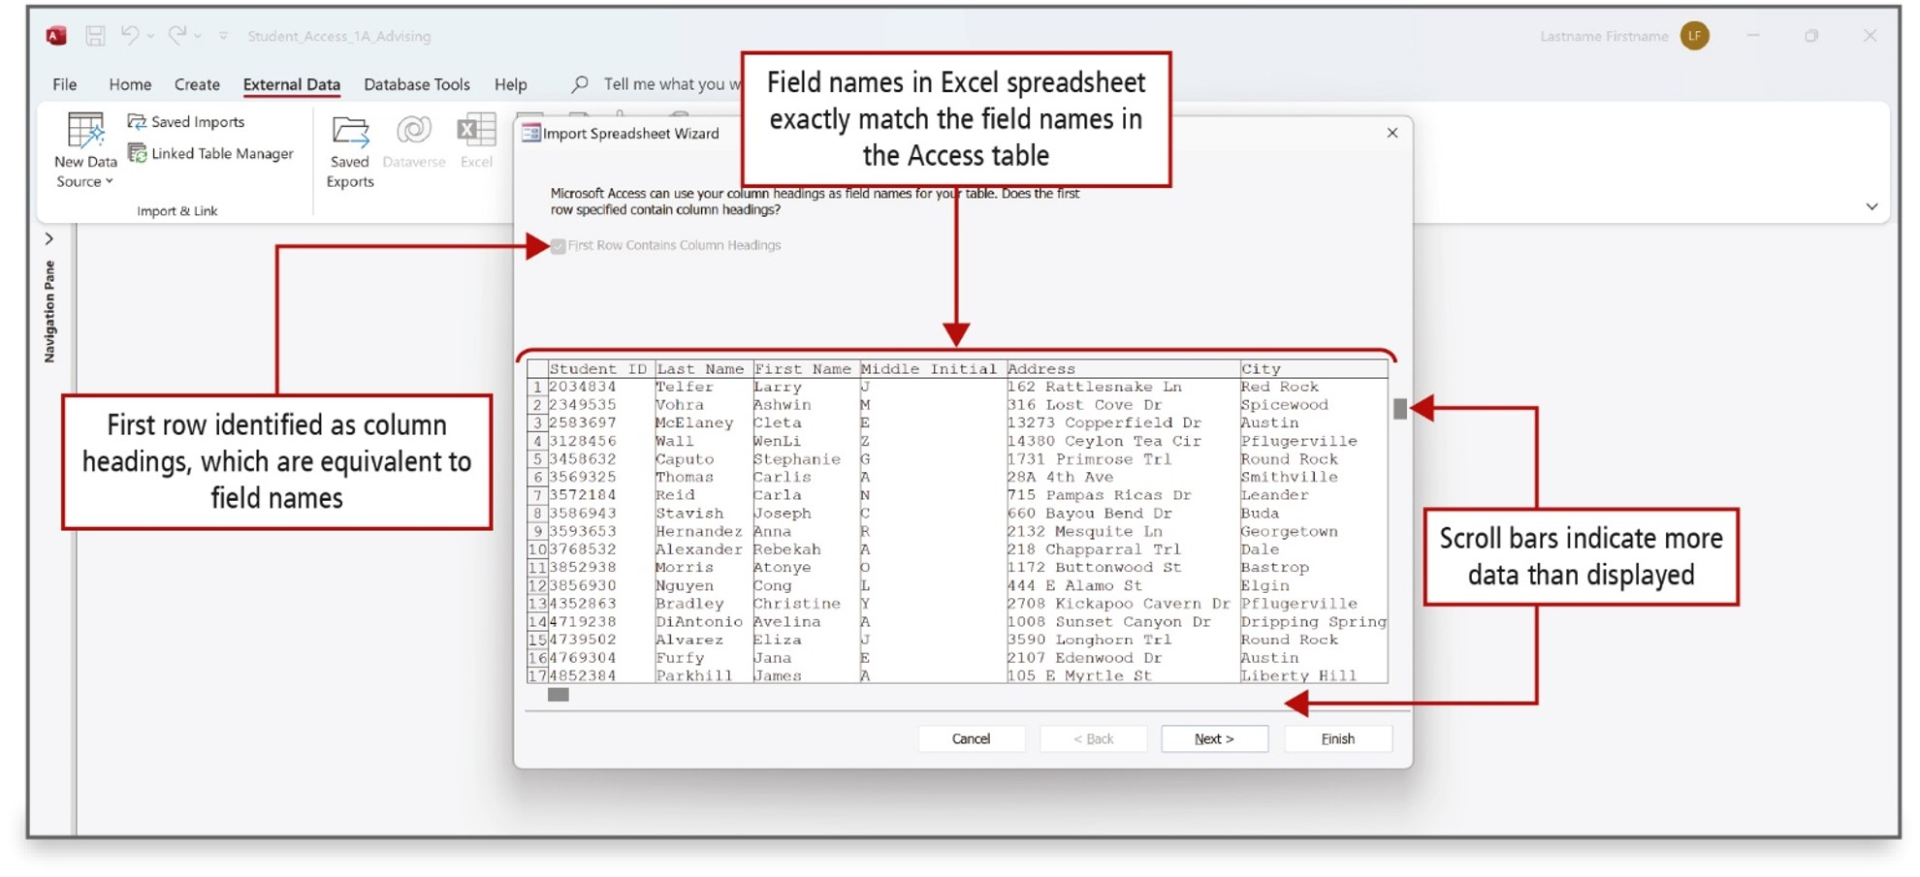
Create a Table and Define Fields in a Blank Desktop Database (8 of 9)
Notes:
You can type records directly into a table or you can import the data from a variety of sources such as Excel. Importing is copying the data from one source to another.
The source file is the file that is being imported. There are three ways to import data from an Excel spreadsheet: import into a new table in the current database, append (copy) the data to an existing table, or link the data to a linked table in the database. A link is a connection to another file. When you link a file, any changes made in one will be made in the other.
To append records to an existing table, the field names and the column headings must be identical. If they are not, the table will not copy. A wizard is a feature of Access that walks you through the process of importing records from one file to another.
The Import Spreadsheet Wizard will walk you step-by-step through the process of importing data.
Long Description:
The screenshot shows an Import Spreadsheet Wizard window from external data on the ribbon of an access file. The import Spreadsheet Wizard window shows a disabled checkbox with label First Row Contains Column Headings and is labeled First row identified as column headings, which are equivalent to field names. A spreadsheet with column headers in first row and data in further rows is labeled Field names in Excel spreadsheet exactly match the field names in the Access table. A scroll bar on the right side of the spreadsheet is labeled Scroll bars indicate more data than displayed.

Slide 16
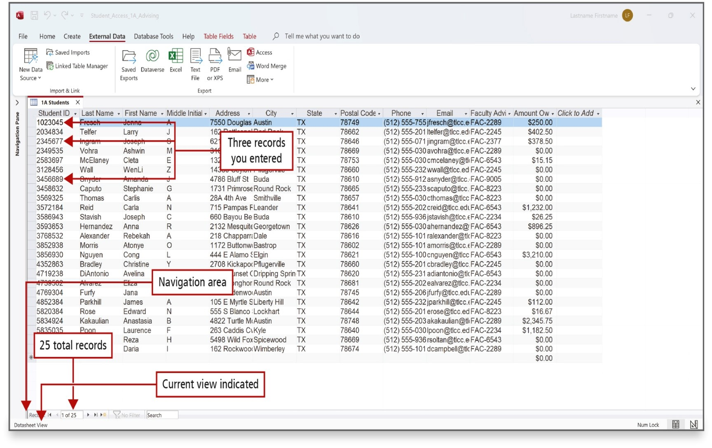
Create a Table and Define Fields in a Blank Desktop Database (9 of 9)
Notes:
The figure shows the 3 typed records and the 22 imported records. The navigation area indicates the number of records in the table and has arrows that you click to move through the records.
Long Description:
A screenshot of an Access file shows students I D field on row 2 column 1, row 4 column 1, row 8 column 1 labeled Three records you entered. Bottom of the navigation pane shutter bar is labeled navigation area. A textbox with 1 of 25 labeled 25 total records is located in the navigation area at the bottom. A text reads Datasheet view at the bottom left corner is labeled current view indicated.

Slide 17
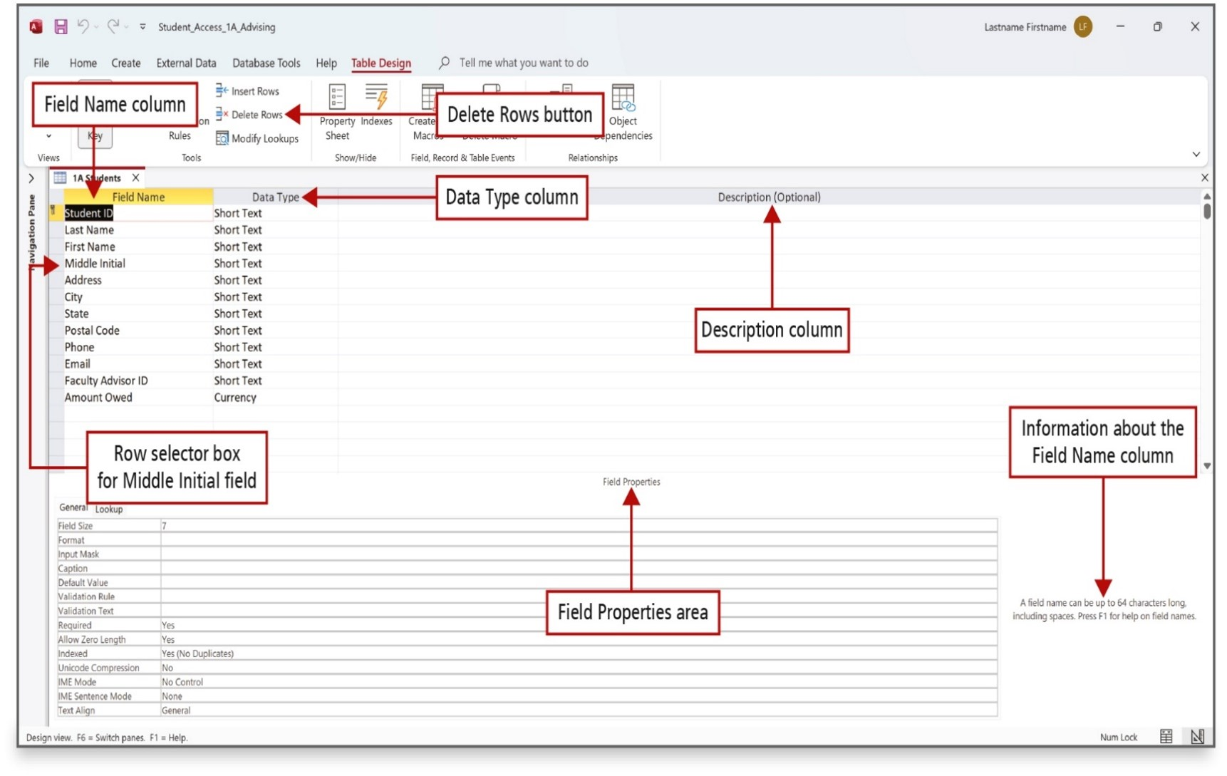
Change the Structure of Tables and Add a Second Table (1 of 6)
Notes:
The structure of a table includes the field names and data types. You can create and modify fields in either Datasheet or Design view.
Design view is used to delete a table field, to add a field description, and to change a field property. Field properties control how the field displays and how data can be entered into the field.
To delete a field, select the field and click Delete Rows on the Design tab.
To add a field description, click in the Description box and enter the text.
To change a field property, select the field, and below in the list of properties, select and change the property.
Long Description:
Selected second row first column is labeled Field Name column. Delete Rows in the menu bar of the ribbon is labeled delete rows button. Text reads Data type on the first row second column and is labeled Data type column. Text reads Description (optional) on the first row third column and is labeled Description column. Middle initial on row 5, column 1 is labeled Row selector box for Middle Initial field. A text reads Field properties in the middle of the object window is labeled Field Properties area. A text reads A field name can be up to 64 characters long including spaces. Press F 1 for help on field names on the right side of the object window is labeled Information about the Field name column.

Slide 18
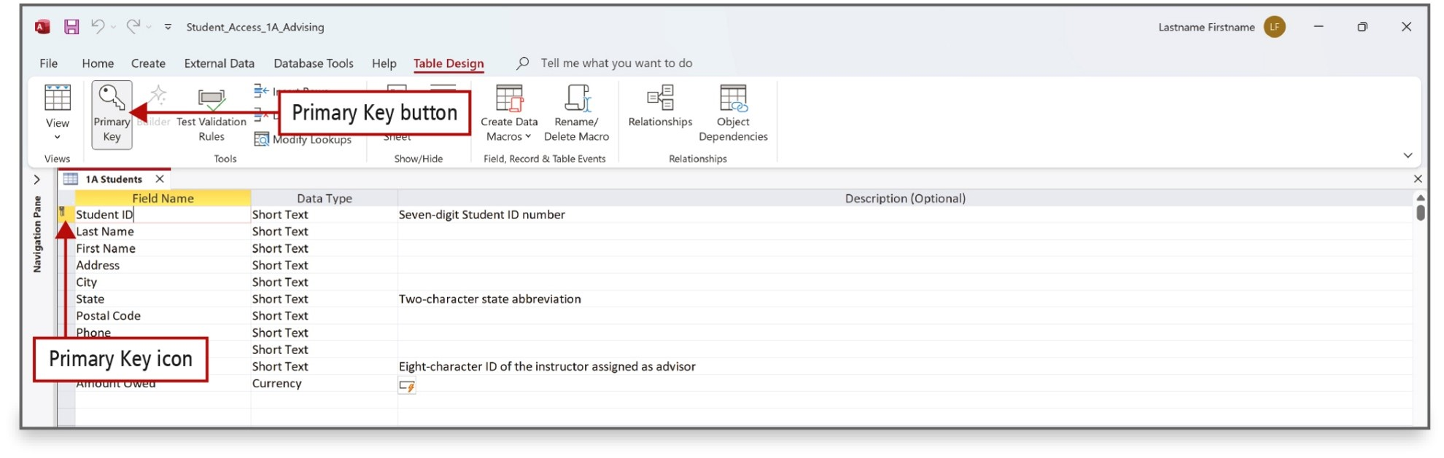
Change the Structure of Tables and Add a Second Table (2 of 6)
Notes:
The primary key is a unique value that identifies a record. A good example of a unique identifier would be a student I D. No student should have the same I D as another, that makes it unique. It is a good practice to create a primary key in every table to make sure you do not enter the same record more than once.

Slide 19
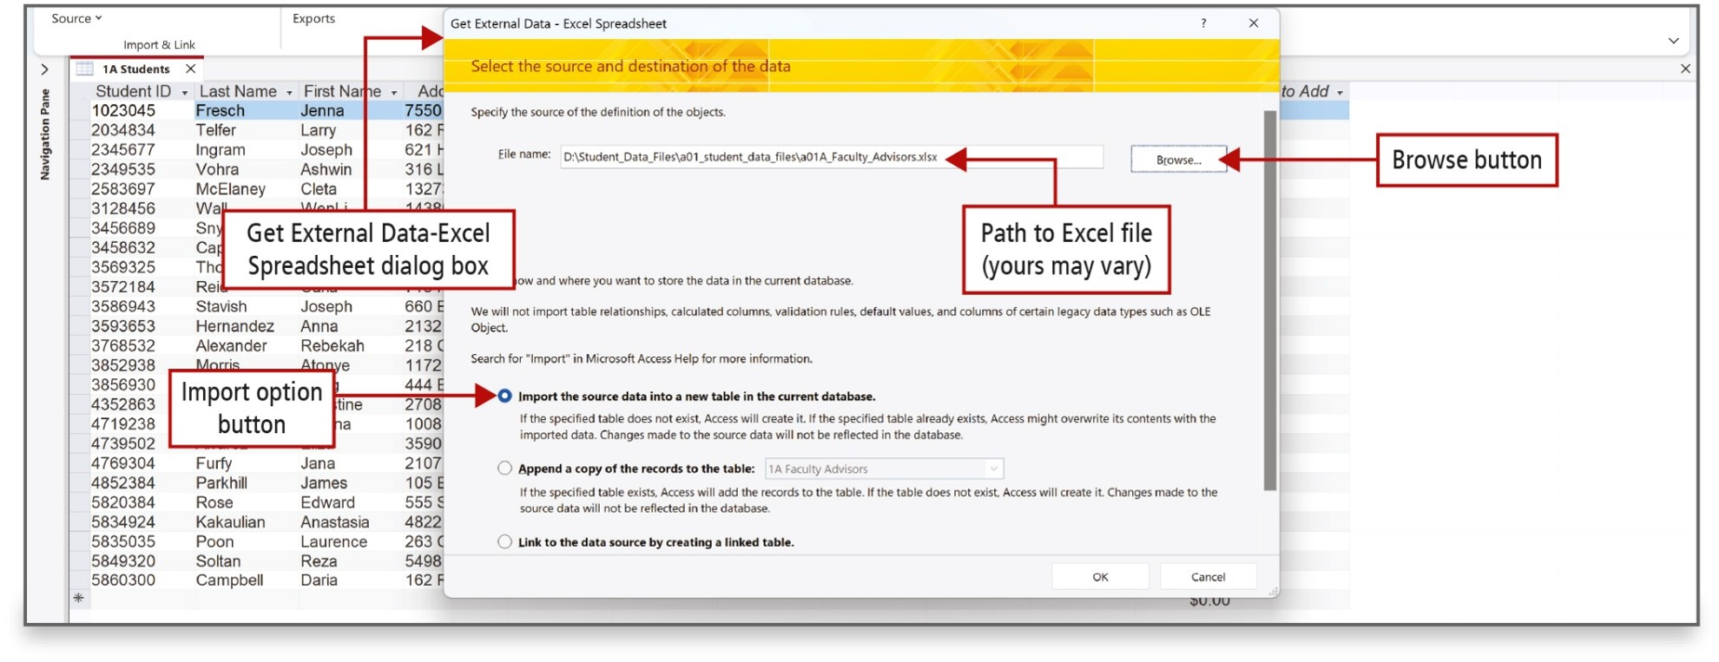
Change the Structure of Tables and Add a Second Table (3 of 6)
Notes:
Excel spreadsheets can be added to Access by importing them or linking them. Begin by identifying the spreadsheet file and specifying import, append, or link. Access will preview the spreadsheet, and you can change the field names or skip selected fields.
Long Description:
The screenshot shows the pop up dialog box titled Get External Data Excel spreadsheet labeled get external data excel spreadsheet dialog box. A text box with a label file name and location is labeled path to excel file (yours may vary). A browse button is labeled Browse button. A checked radio button with label import the source data into a new table in the current database is labeled Import option button.

Slide 20
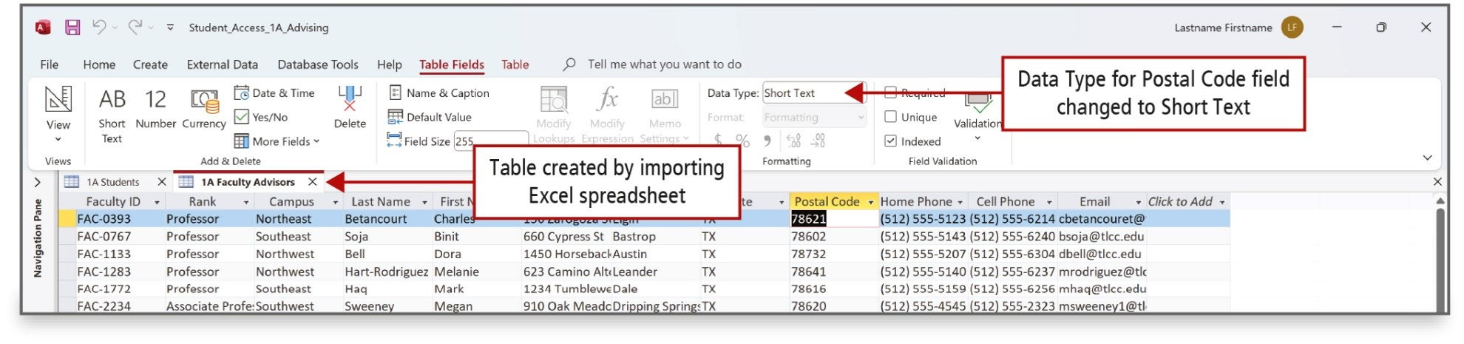
Change the Structure of Tables and Add a Second Table (4 of 6)
Notes:
The figure shows the successful importation of the spreadsheet.

Slide 21
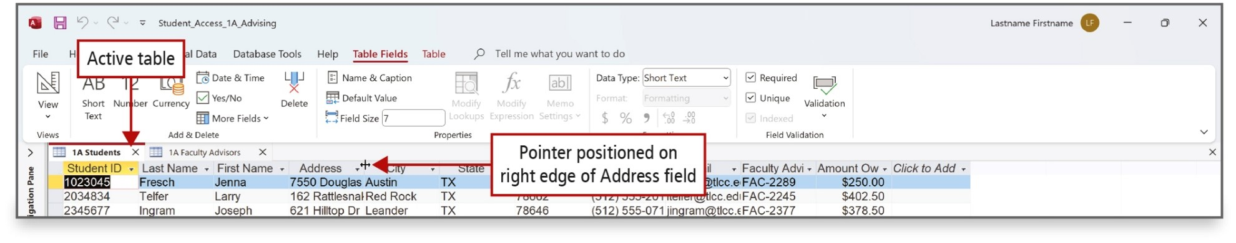
Change the Structure of Tables and Add a Second Table (5 of 6)
Notes:
You can adjust the column widths in a table displayed in Datasheet view by using techniques similar to those you use for Excel spreadsheets. Place the pointer at the right edge of a field and drag left or right to decrease or increase its width. You can also use Best Fit to have Access automatically set the width to fit the contents of the field.

Slide 22
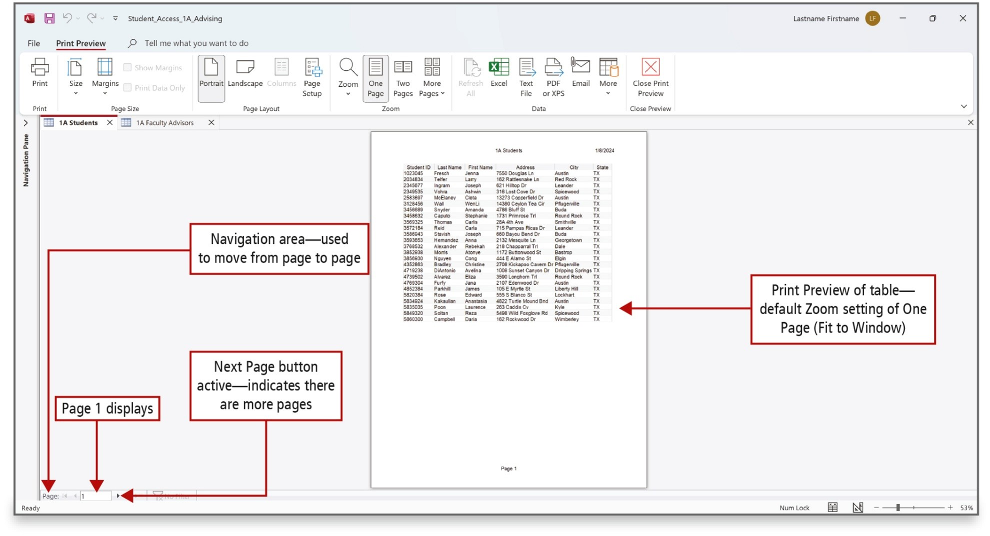
Change the Structure of Tables and Add a Second Table (6 of 6)
Notes:
When you need to print an Access table, it is best practice to use Print Preview to view your table to make sure all the information is readable. Many times, you have to change the orientation from Portrait to Landscape to see all the fields. You can also use Fit to Window to see how the table will look. If the table covers more than one page, you will see the Next Page button available to print.
Long Description:
The screenshot shows print preview in the menu bar of ribbon is selected and underlined. Text reads Page at the left bottom of the object window is labeled Navigation area used to move from page to page. Numerical 1 inside a text box adjacent to page is labeled Page 1 displays. A next button adjacent to text box is labeled Next page button active, indicates there are more pages. A page at the center of the object window is labeled print preview of table default zoom setting of one page (fit to window).

Slide 23
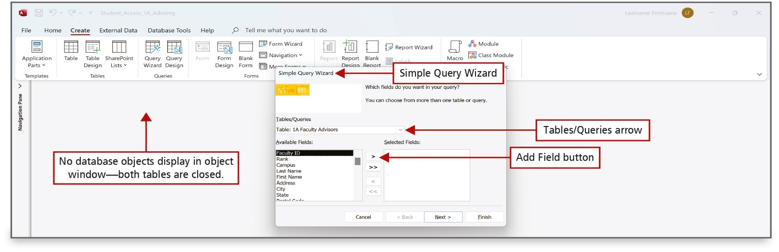
Create a Query, Form, and Report (1 of 5)
Notes:
A query is a database object used to answer a question by retrieving data that you specify when you design the query. You can use the Simple Query Wizard to quickly create a select query.
A select query is one type of query that retrieves data from one or more tables or queries. It creates a subset of the data to answer specific questions. The objects used in the query are the query’s data source.
In a select query, you specify which fields you want to appear in your answer. No other fields will appear.
Access runs the query or performs the actions in your query to answer the question. The records that match the criteria display in datasheet form.
The figure shows one of the steps in the Simple Query wizard, where the table and some of its fields are selected.
Long Description:
The screenshot shows access file with clear object window labeled no database objects display in object window, both tables are closed. A pop-up dialog box titled Simple Query wizard is labeled Simple Query Wizard. An arrow on the textbox with Table: 1 A faculty advisors with label Tables forward slash queries is labeled Tables forward slash Queries arrow. A button reads a rightward arrow head labeled add field button is located at the center two text boxes titled available fields on the left and selected fields on the right.

Slide 24
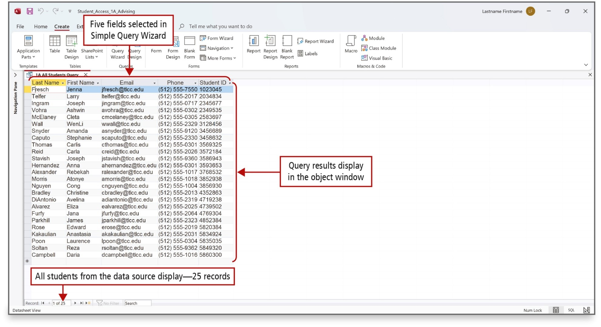
Create a Query, Form, and Report (2 of 5)
Notes:
The results of a query, the answer to your question, displays only the information from the selected data source and specified fields.
Long Description:
The screenshot shows the selected five columns in a table is labeled five fields selected in Simple Query Wizard. The table with data in the rows and columns in the object window is labeled Query results display in the object window. A textbox reads of 1 of 25 at the bottom of the object window is labeled All students from the data source display 25 records.

Slide 25
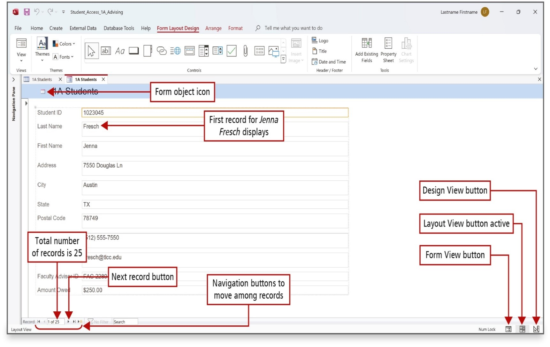
Create a Query, Form, and Report (3 of 5)
Notes:
A form is an object that can be used for data entry, to edit data, or display the data from a table or a query in Form view. The fields are in the same order that they were created in the table.
In Form view, you view the specific records in the table one record at a time. Layout view is useful to view the design of the form.
Lond Description:
The screenshot shows an icon with text boxes and field names labeled form object icon located on the top of the object window. A field name Last name with a text box with text reads Fresch labeled First record for Jenna Fresch displays. A text box with 1 of 25 is labeled a total number of records is 25 located at the bottom of the object window. Next button labeled Next record button is located adjacent to the text button with 1 of 25. The previous buttons, and next buttons at the bottom are labeled Navigation buttons to move among records. Three buttons, form view button, layout view button active, and the design view button are on the bottom right corner of the object window. The form view button has a rectangle with text boxes and a field name icon. The layout view button active has A rectangle with two rows and two columns icon. A design view button has a set square and a ruler icon.

Slide 26
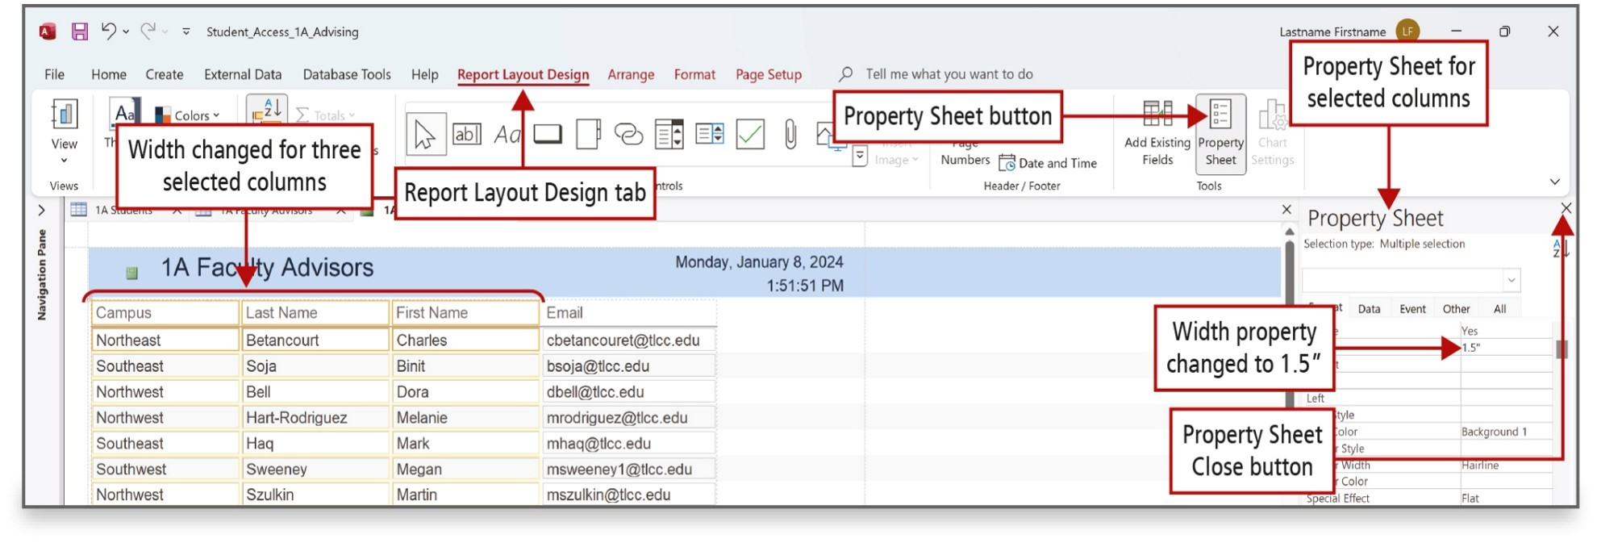
Create a Query, Form, and Report (4 of 5)
Notes:
A report is an object that displays all the information from a table in an easy-to-read format which is suitable for printing. Reports can be created to summarize information.
To make precise changes to a report object, use its Property Sheet. A Property Sheet contains the properties—characteristics—of selected items and displays on the right side of the screen.
Long Description:
The screenshot shows Report Layout Design tool labeled Report Layout Design tab from menu bar of the ribbon. The selected and extended three columns are labeled width changed for three selected columns. An icon with checkboxes and lines with text reads property sheet is labeled property sheet button. A pane on the right is titled Property Sheet and is labeled Property Sheet for selected columns. A text box reads 1.5 inches labeled Width property changed to 1.5 inches located in the property sheet pane. A cross button on the top right corner of the property sheet pane is labeled property sheet close button.

Slide 27
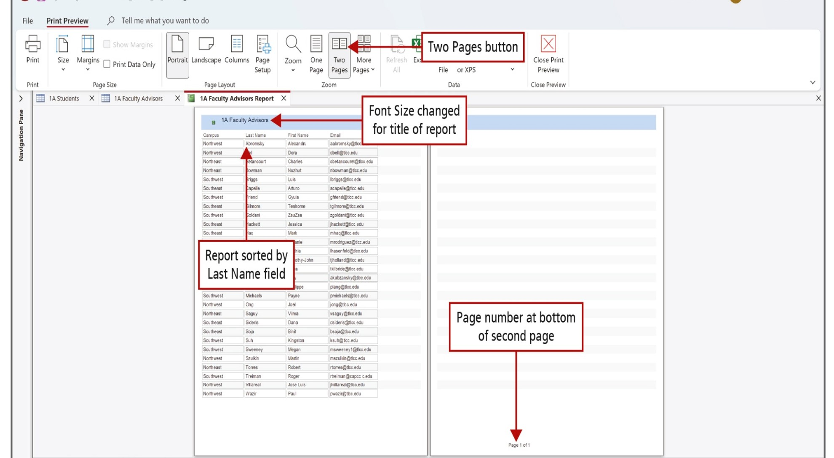
Create a Query, Form, and Report (5 of 5)
Notes:
Once formatted and sorted, ascending by last name in this example, use Print Preview to see how the report will print.
Long Description:
The screenshot shows the print preview tool selected and underlined. An icon with an open two pages with text reads two pages is labeled two pages button. The text reads 1 A Faculty Advisors on the top of the left page is labeled font size changed for title of report. The field name Last name on the second column is labeled Report sorted by Last Name field. The text reads page 1 of 1 at the bottom of the second page is labeled Page number at the bottom of second page.

Slide 28
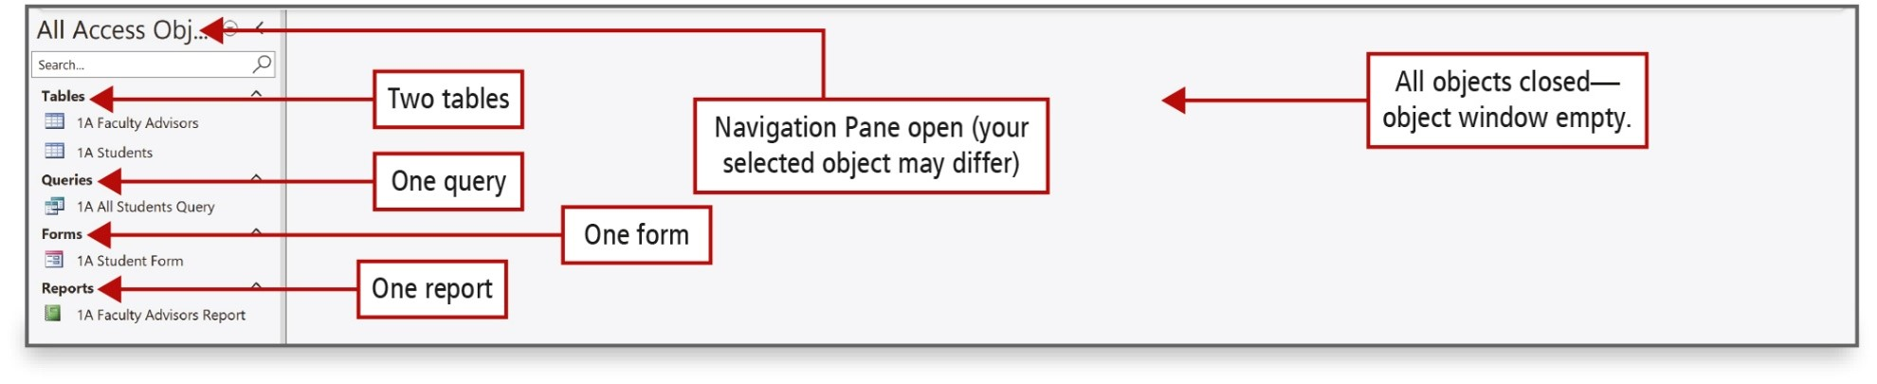
Close a Database and Close Access
Notes:
When you close a table, changes made to records are saved automatically. Changes to structure or adjusted column widths require saving the object again. If the Navigation Pane is open, all the objects created will be listed.
When you are finished using the database, close the database objects, and exit Access.
Long Description:
The screenshot shows the navigation pane labeled Navigation pane open (your selected object may differ). In the navigation pane, two tables under tables labeled two tables; 1 query under queries labeled one query; 1 form under forms labeled one form; and 1 report under Reports labeled one report from top to bottom. The object window is empty and is labeled All objects closed, object window empty.

Slide 29
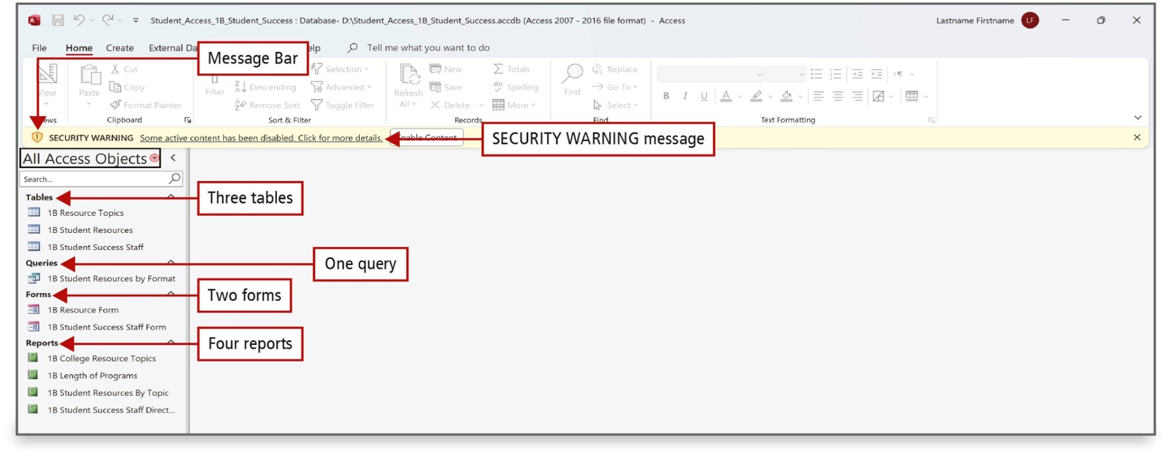
Open an Existing Database
Notes:
Sometimes you will need to open an existing database and save it with a different name to preserve the original database.
The Navigation Pane displays the database objects, and the Message Bar displays a security message.
Long Description:
The screenshot shows a caution icon with text below the ribbon labeled message bar. The caution icon with text reads Security Warning Some active content has been disabled. Click for more details is labeled security warning message. The navigation pane has All access objects. Tables with three table lists are labeled three tables. Queries with one list item are labeled one query. Forms with two list items are labeled two forms. Reports with four list items are labeled four reports.

Slide 30
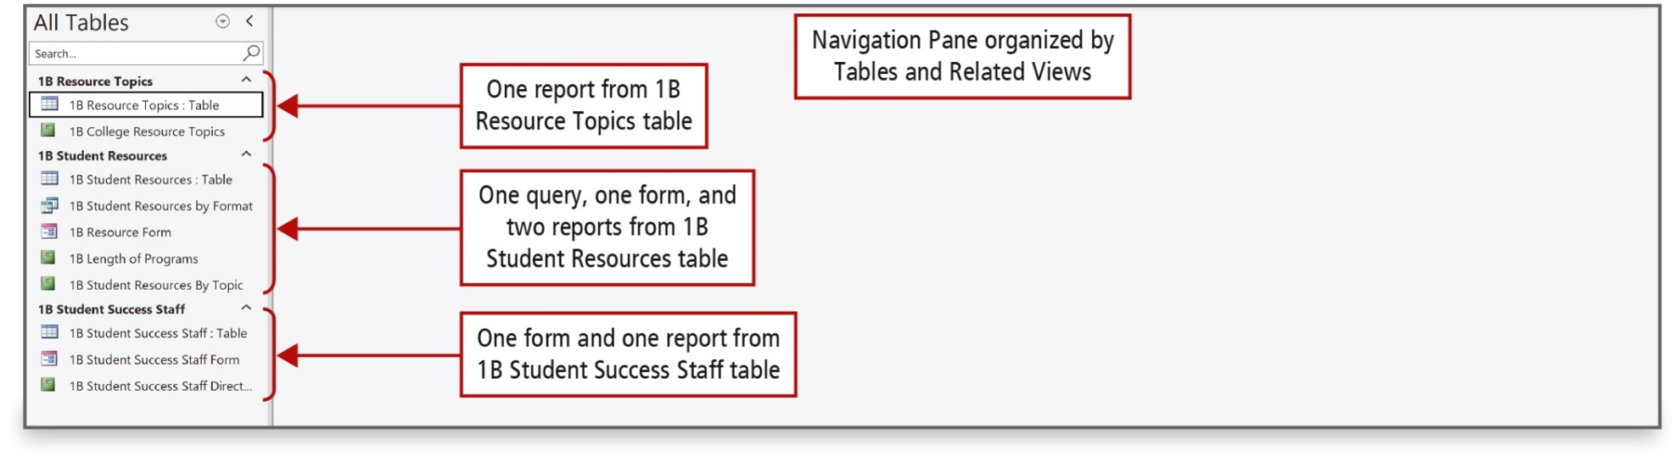
Organize Objects in the Navigation Pane
Notes:
The Navigation Pane groups and displays your objects in a predefined arrangement. The Tables and Related Views category groups objects by the table to which they are related. This grouping is helpful because you can easily see which queries, forms, or reports were created for a particular table. If a query, form, or report was created by using more than one table, each table group will display that object.
Long Description:
The screenshot shows a navigation pane titled all tables. The navigation pane is labeled navigation pane organized by tables and related views. A table selected from a list of two items under 1 B resource Topics is labeled one report from 1 B resource topics table. Five list items under 1 B student resources are labeled one query, one form, and two reports from 1 B Students resources table. Three list items from 1 B student success staff are labeled one form and one report from 1 B student success staff table.

Slide 31
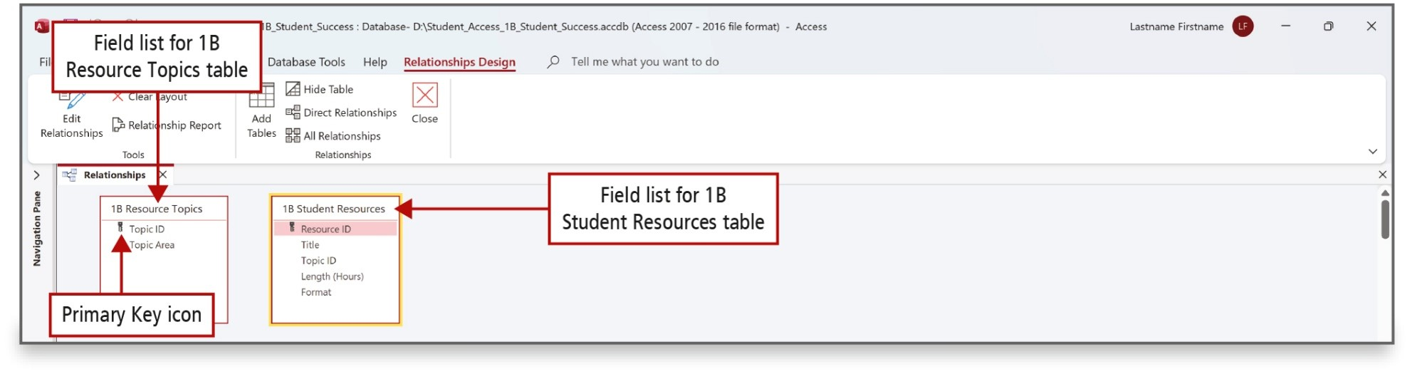
Create Table Relationships (1 of 4)
Notes:
After you have a table for each subject in your database, you must provide a way to connect the data in the tables when you need to obtain meaningful information from the stored data. To do this, create common fields in the related tables, and then define table relationships. A relationship is an association that you establish between two tables based on common fields.
A field list—a list of the field names in a table—for each of the two table objects displays, and each table’s primary key is identified by a key icon.

Slide 32
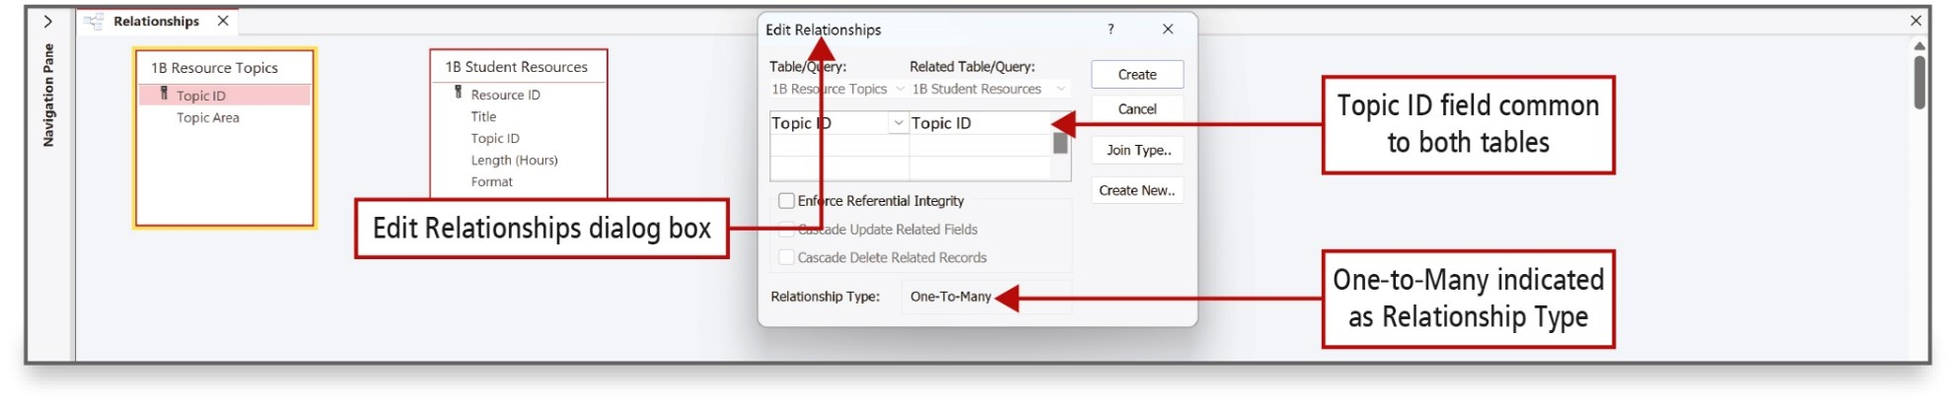
Create Table Relationships (2 of 4)
Notes:
A table relationship works by matching data in two fields—the common field. In these two tables, the common field has the same name—Topic I D.
When the relationship is established, it will be a one-to-many relationship, which is the most common type of relationship in Access.
Long Description:
The Access form displays two tables 1 B Resource Topics with the fields Topic I D (primary key) and Topic Area and 1 B Student Resources with the fields Resource I D, Title, Topic ID, Length (Hours), and Format. A callout points to the Edit Relationships dialog box. There are two dropdowns: Table slash Query and Related Table slash Query. The dropdown Table slash Query is set to 1 B Resource Topics and the dropdown Related Table slash Query is set to 1 B Student Resources. A dropdown list box shows two columns with Topic I D selected in each. A callout pointing to the selected field Topic I D reads, Topic I D field common to both tables. Below the dropdown list box, there is an unchecked check box labeled Enforce Referential Integrity. At the bottom, the field Relationship Type colon is set to One-to-Many. The corresponding callout reads, One-to-Many indicated as Relationship Type.

Slide 33
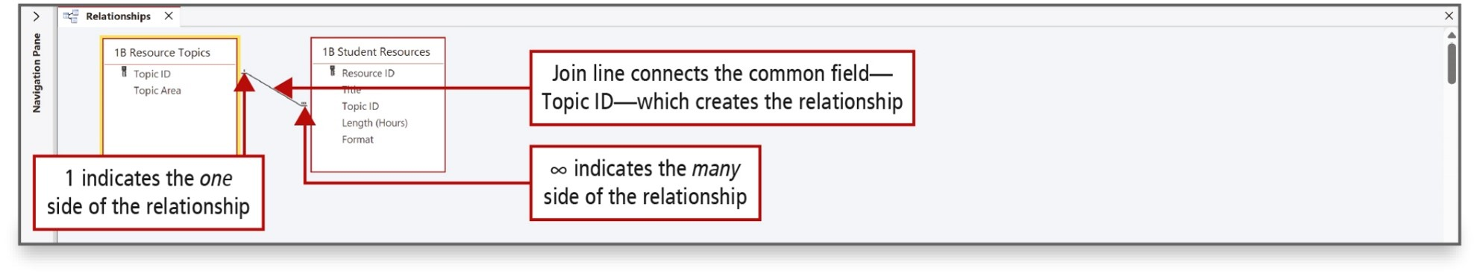
Create Table Relationships (3 of 4)
Notes:
In the 1B Resource Topics table, Topic I D is the primary key. In the 1B Student Resources table, Topic I D is the foreign key field. The foreign key is the field in the related table used to connect to the primary key in another table.
A join line—the line connecting or joining the two tables—displays between the two tables. The join line connects the primary key field—Topic I D—in the 1B Resource Topics field list to the common field—Topic I D—in the 1B Student Resources field list.
Long Description:
The screenshot shows a selected textbox with a list and 1 is labeled 1 indicates the one side of the relationship. A diagonal line between the first textbox on the left and second text box on the right is labeled join line connects the common field, topic I D which creates the relationship. The infinitive symbol near the second table on the right is labeled infinitive indicates the many side of the relationship.

Slide 34
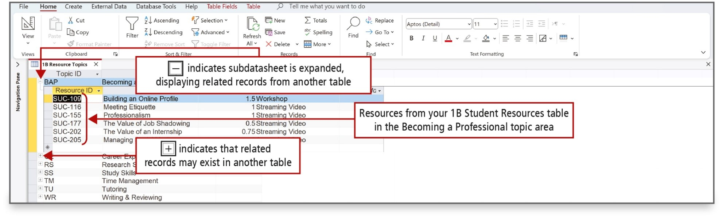
Create Table Relationships (4 of 4)
Notes:
When you open a table on the one side of a relationship, the related records from the table on the many side are available for you to display and to modify.
The related records are displayed in a subdatasheet.
Long Description:
The screenshot shows a button with minus labeled [collapse underscore btn] indicates Subdatasheet is expanded, displaying related records from another table. A list of rows from column Resource I D is labeled Resources from your 1 B Student Resources table in the Becoming a Professional topic area. The button with plus is labeled [expand underscore btn] indicates that related records may exist in another table.

Slide 35
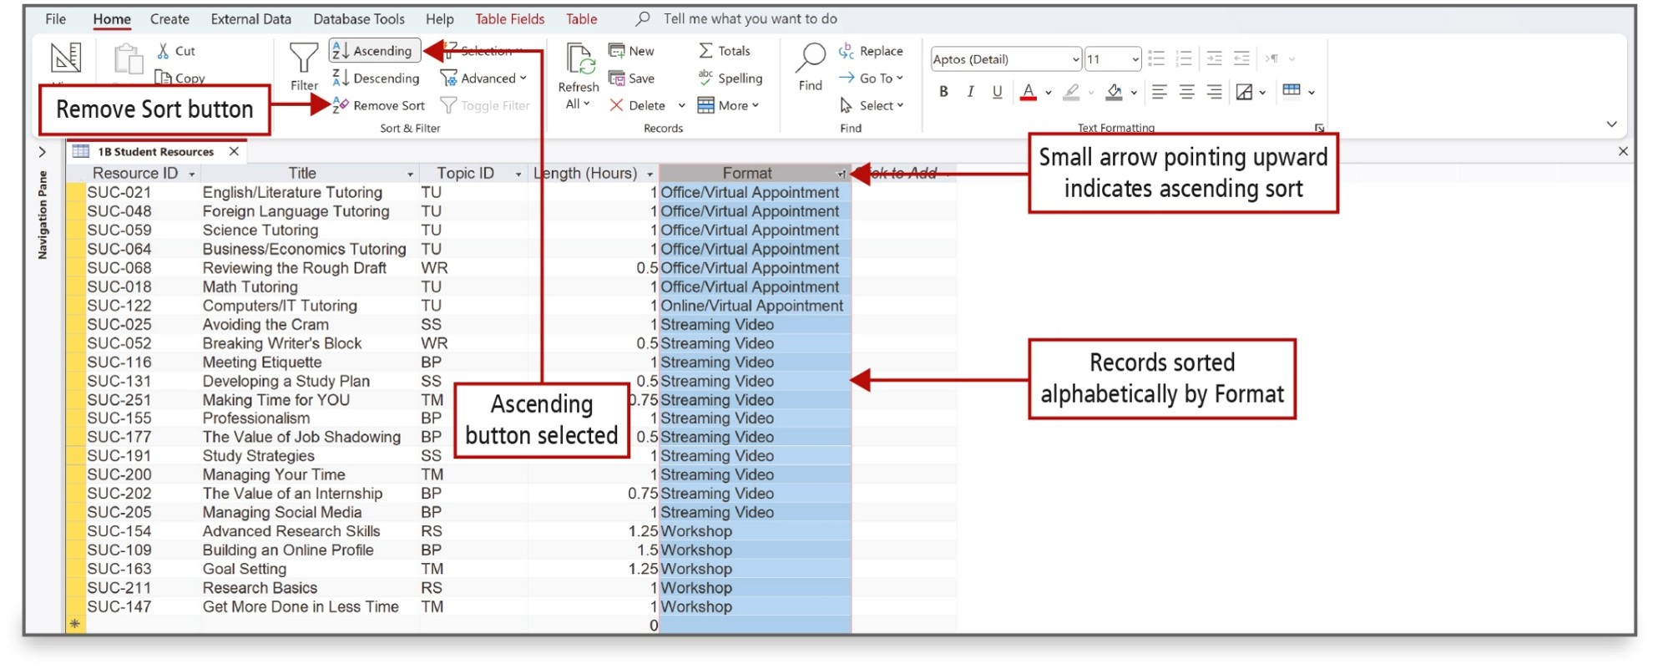
Sort Records in a Table (1 of 2)
Notes:
Data can be sorted in either ascending order or descending order.
Ascending order sorts text alphabetically (A to Z) and sorts numbers from the lowest number to the highest number.
Descending order sorts text in reverse alphabetical order (Z to A) and sorts numbers from the highest number to the lowest number.
Long Description:
The screenshot shows Remove Sort tool in the menu bar of ribbon is labeled Remove Sort button. A selected button with A Z downward arrow Ascending is labeled Ascending button selected. An upward arrow on the right edge of a selected column with field name Format is labeled Small arrow pointing upward indicates ascending sort. The selected records under field name format is labeled Records sorted alphabetically by format.

Slide 36
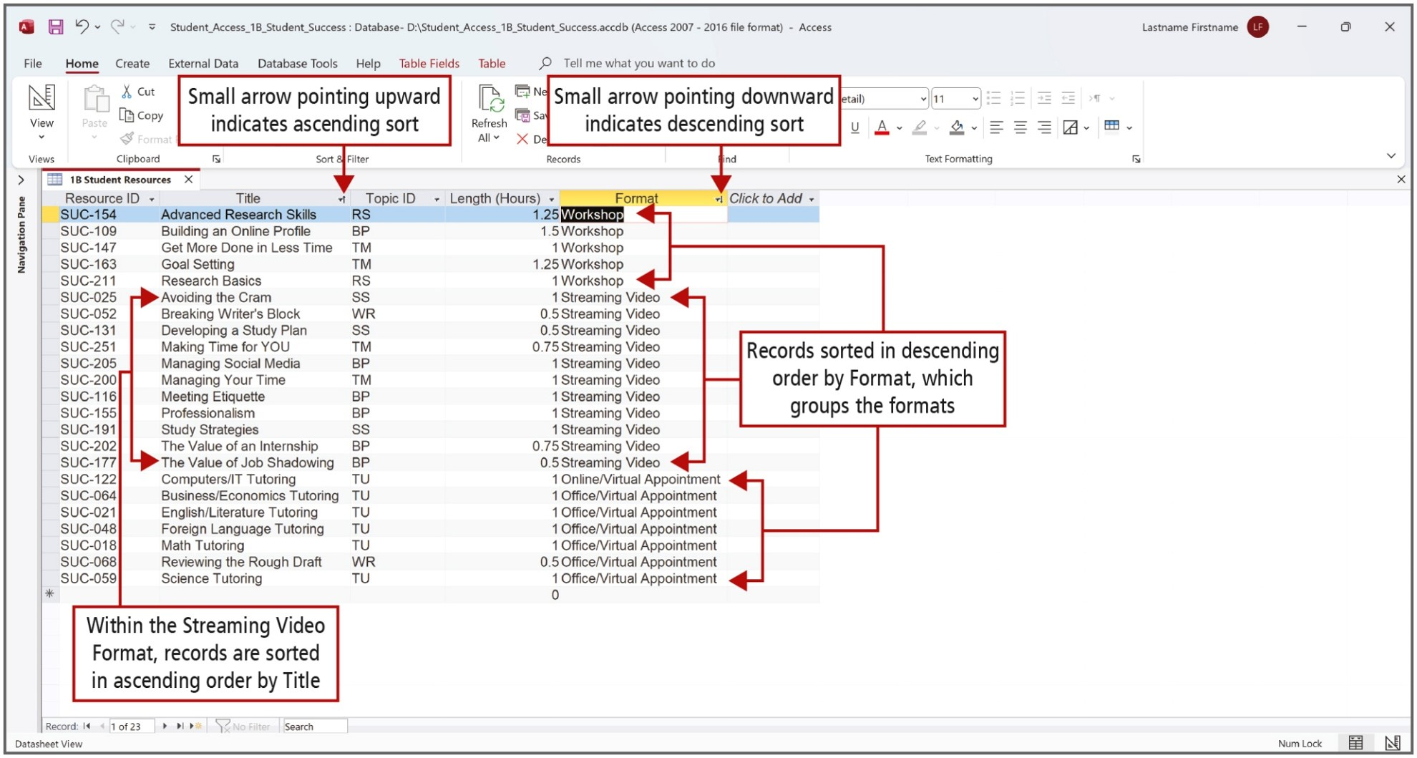
Sort Records in a Table (2 of 2)
Notes:
To sort a table on two or more fields, first identify the fields that will act as the outermost sort field and the innermost sort field. The outermost sort field is the first level of sorting, and the innermost sort field is the second or final level of sorting.
In the figure, the records are sorted first by the Format field and then by the Title field within each format.
Long Description:
The table shows the fields Resource I D, Title, Topic I D, Length (Hours), Format, and Click to Add. The annotations pointing to different elements are as follows: an up arrow next to the dropdown symbol in the Title field: Small arrow pointing upward indicates ascending sort; an up arrow next to the dropdown symbol in the Format field: Small arrow pointing downward indicates descending sort; 5 entries labeled Workshop, 11 entries labeled Streaming Video, and 1 entry labeled Online or Virtual Appointment and 6 entries labeled Office or Virtual Appointment under the Format field: Records sorted in descending order by Format, which groups the formats; from the entry labeled Avoiding the Cram to the entry labeled The Value of Job Shadowing under the Title field: Within the Streaming Video Format, records are sorted in ascending order by Title.

Slide 37
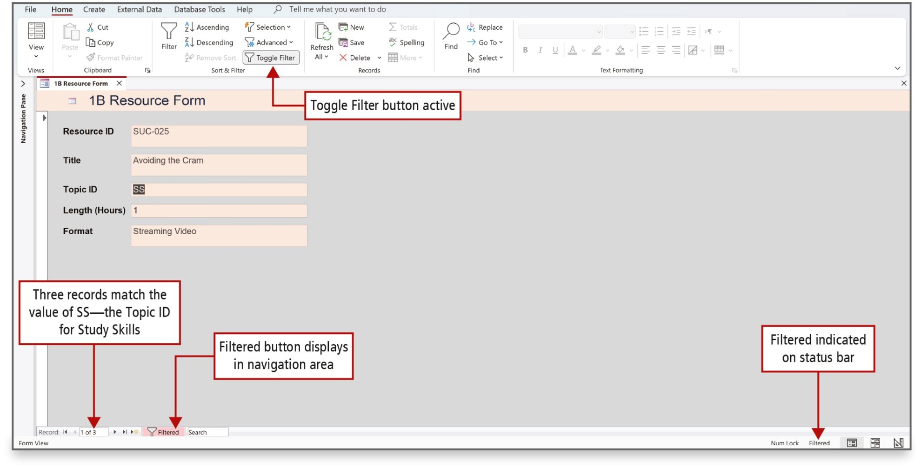
Filter Records (1 of 2)
Notes:
Filtering records within a form provides a way to ask questions of the database without constructing a query.
The Filter By Selection command displays only the records that contain the value in the selected field; in the example, records with a Topic ID of SS.
Long Description:
The screenshot shows a filter icon with Toggle filter selected in the menu bar of the ribbon labeled Toggle Filter button active. A textbox with 1 of 3 at the bottom left corner is labeled three records match the value of S S, the topic I D for study skills. A highlighted filter icon with text reads filtered at the bottom is labeled filtered button displays in navigation area. Text reads filtered at the right bottom is labeled Filtered indicated on status bar.

Slide 38
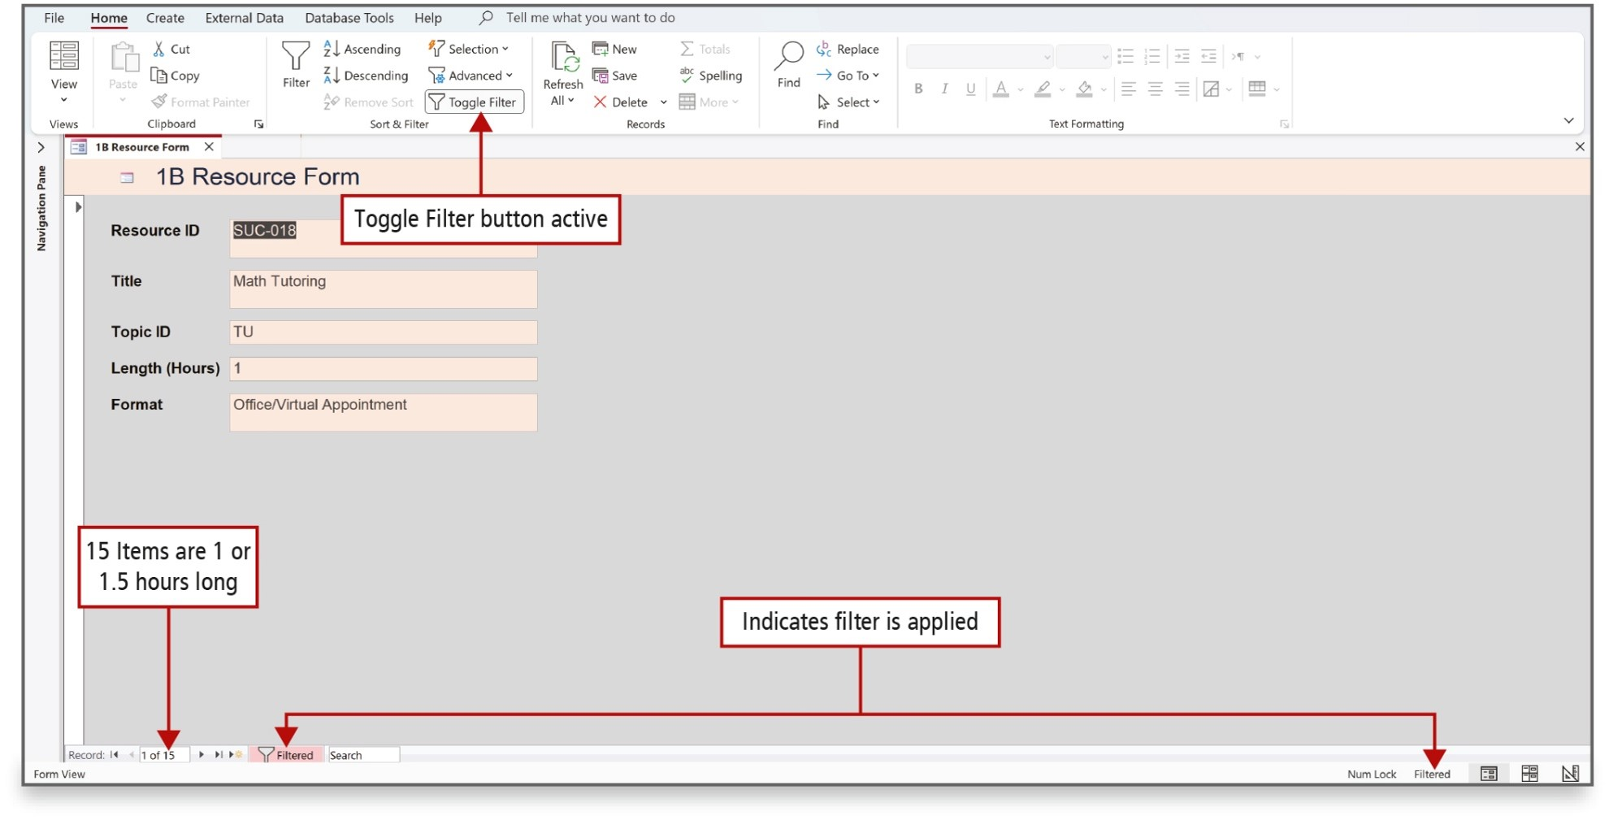
Filter Records (2 of 2)
Notes:
The Filter By Form command filters the records based on one or more fields or based on more than one value in the same field.
The Filter by Form window displays all of the field names, but without any data. In the empty text box for each field, you can enter a value or select a value from a list. The Look for and Or tabs display at the bottom.
An OR condition displays records where at least one of two values—1 or 1.5—is present in the selected field.
Long Description:
The screenshot shows the filter icon with text reads Toggle filter labeled Toggle filter button active. A textbox with 1 of 15 at the bottom is labeled 15 items are 1 or 1.5 hours long. A highlighted filter icon with text reads filtered on the bottom left and filtered on the bottom right are labeled indicates filter is applied.

Slide 39

Questions

Slide 40

Copyright
This work is protected by United States copyright laws and is provided solely for the use of instructors in teaching their courses and assessing student learning. Dissemination or sale of any part of this work (including on the World Wide Web) will destroy the integrity of the work and is not permitted. The work and materials from it should never be made available to students except by instructors using the accompanying text in their classes. All recipients of this work are expected to abide by these restrictions and to honor the intended pedagogical purposes and the needs of other instructors who rely on these materials.

